Slide 1



Analysis on the Billboard Chart
The Hot 100:
Paul Cho

Slide 2

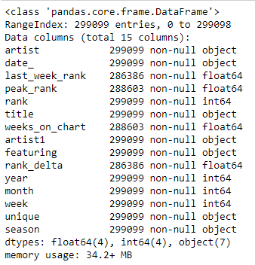
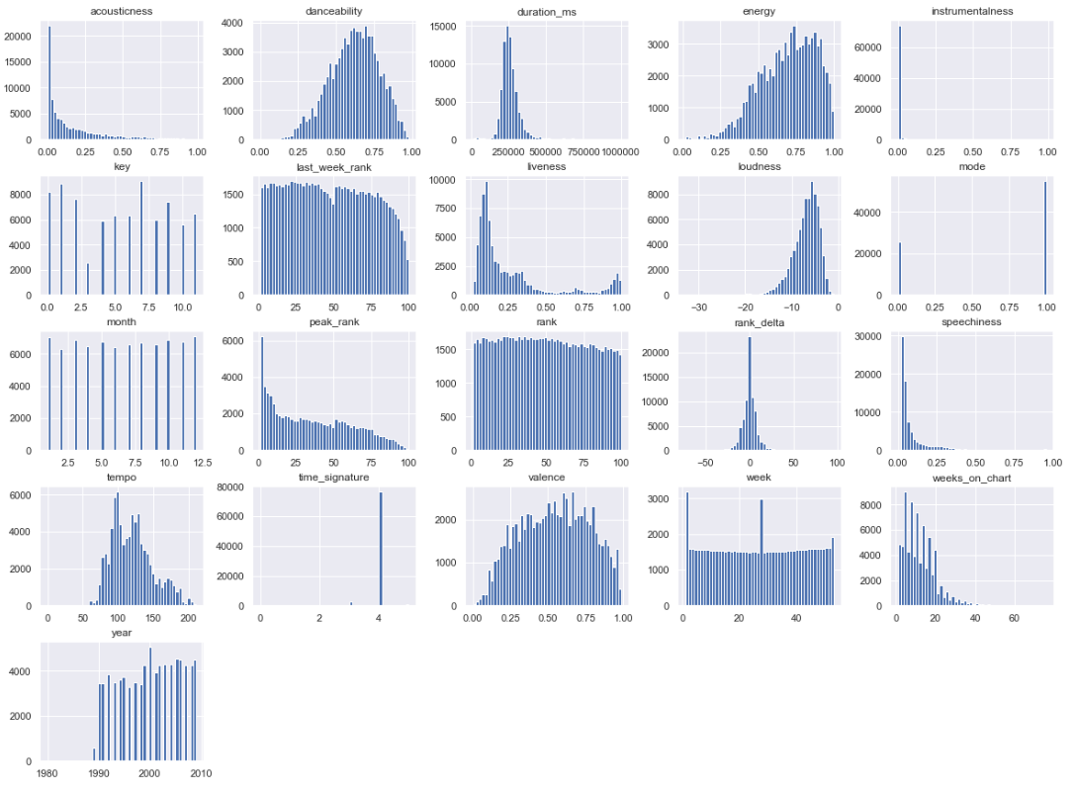
Billboard Hot 100:
The music industry standard record chart in the United States for songs.
Chart rankings are based on sales (physical & digital), radio play, and online streaming in US
~ 300,000 tracks cumulated since August 16th of 1958
~ 28,000 unique tracks removing the duplicates
Notes:
Obtain features such as:
-1W Rank
CW Rank
Peak Rank
Date
(Season, Month, Year, WoW Delta etc. )

Slide 3

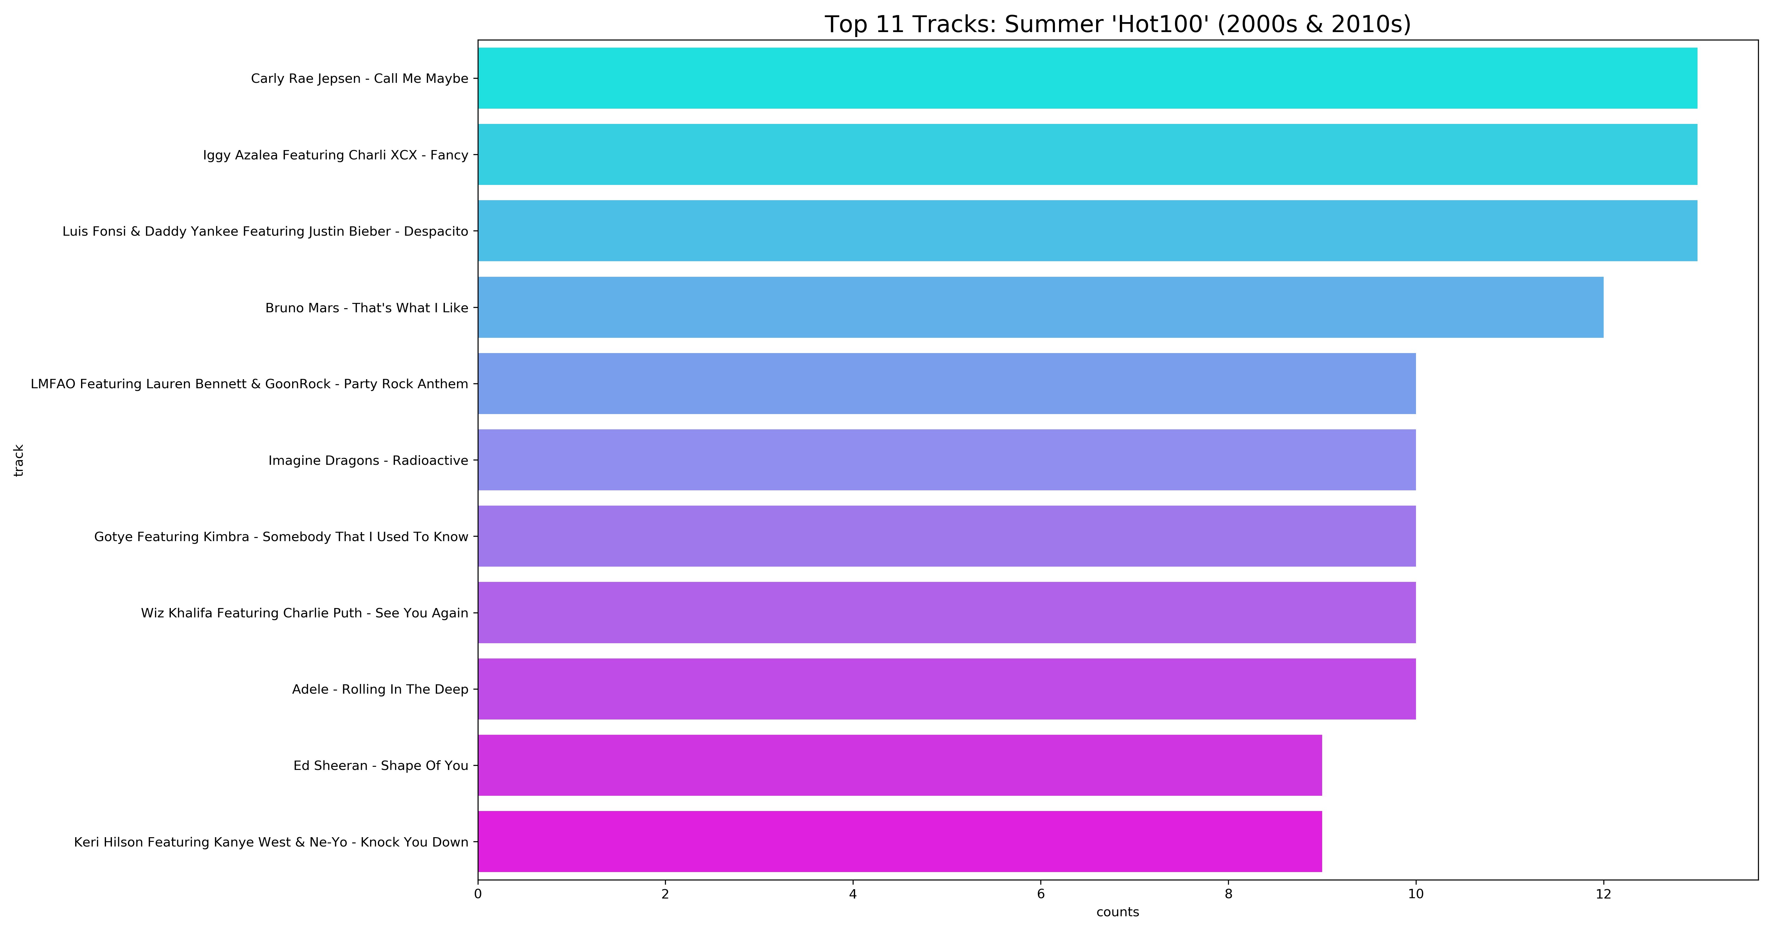

What are some noticeable Summer Songs for past 19 years?
Weeks on chart >= 12. Rank <= 5, Date >= 2000-01-01, Months in [6.7.8]

Slide 4


Lets do a simple validation:
Does Billboard look into data before choosing the Billboard's Top Artist Winner?
:Ed Sheeran
Notes:
Unlike other awards, such as the Grammy Award, the Billboard Music Awards finalists are based on album and digital songs sales, streaming, radio airplay, touring, and social engagement data provided by Nielson.
The 2018 awards are based on the reporting period of April 8, 2017 through March 31, 2018.

Slide 5
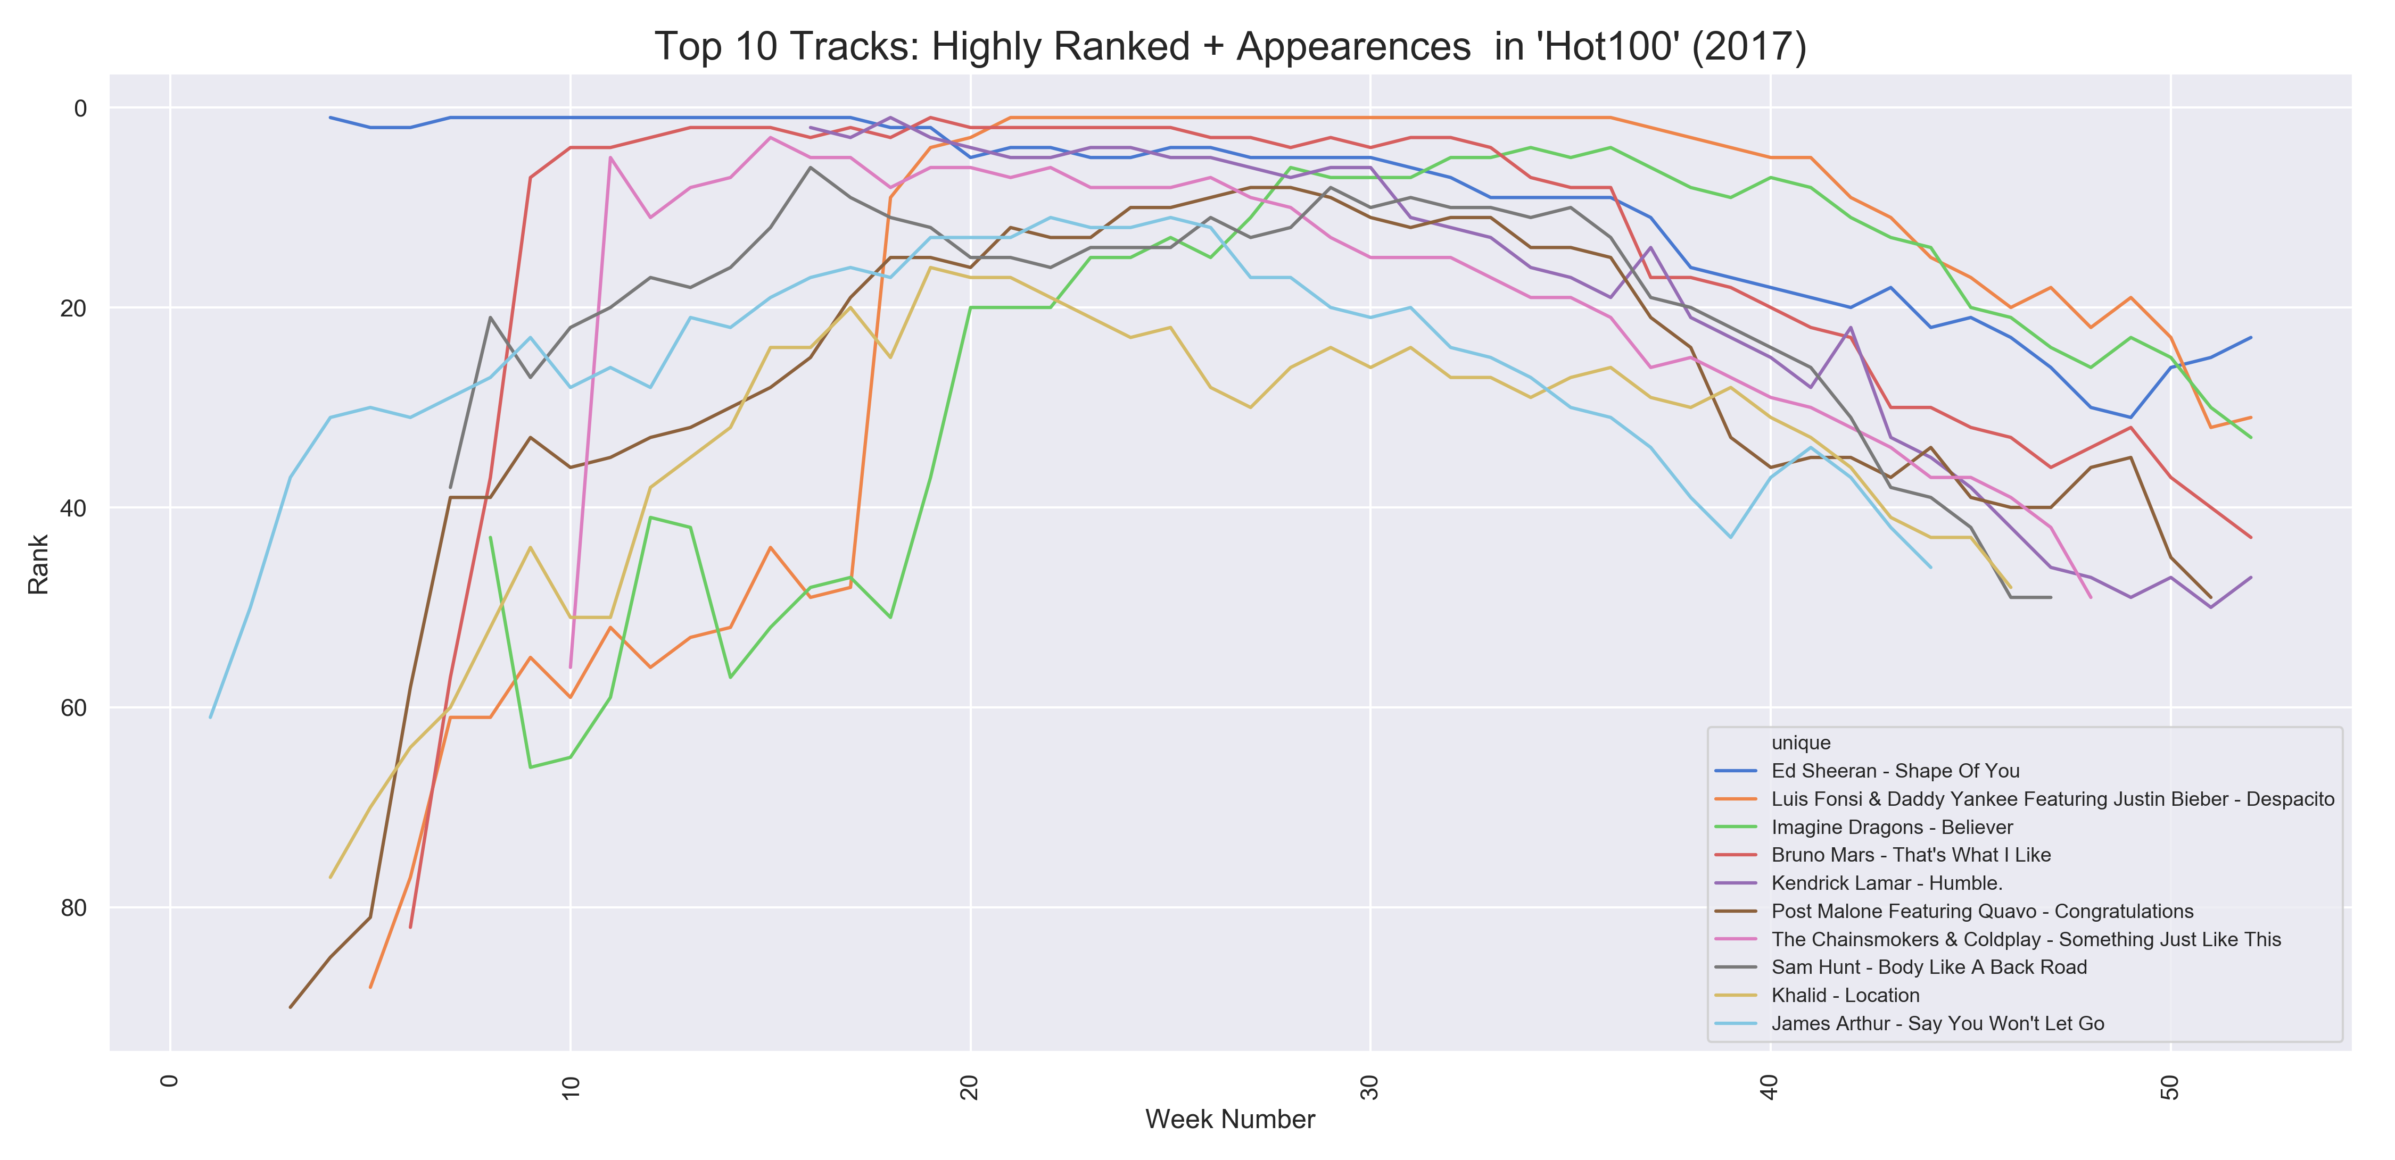
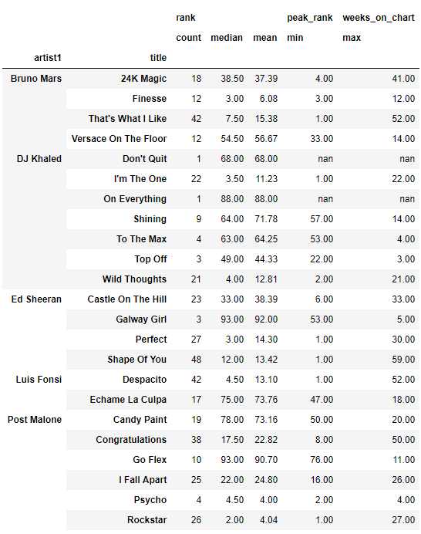
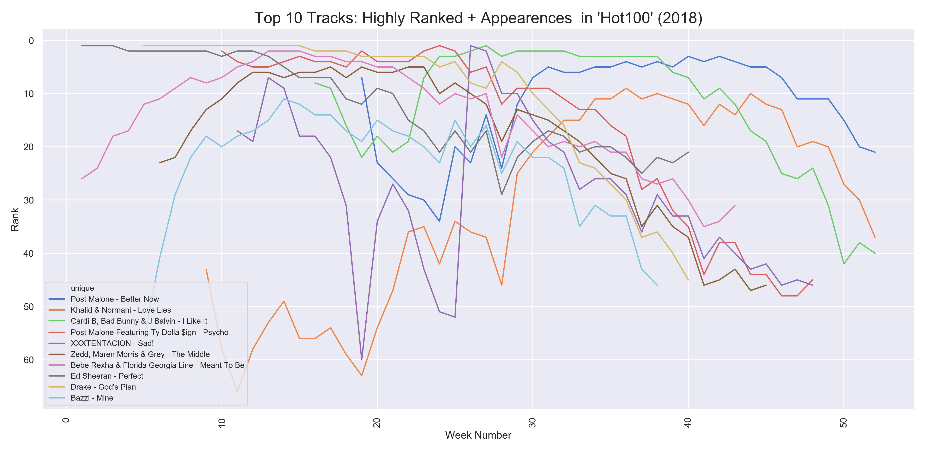
rank<=50: appearances in 2017
April 8, 2017 - March 31, 2018
rank<=50: appearances in 2018

Slide 6
Key
the estimated overall key of the track;
e.g. 0 = C, 1 = C♯/D♭, 2 = D...etc
Mode
the modality (major or minor) of a track;
Major = 1, Minor = 0
Danceability
how suitable a track is for dancing; (0.0 - 1.0)
Energy
perceptual measure of intensity and activity; (0.0 -1.0)
Valence
musical positiveness conveyed by a track; (0.0 -1.0)
Tempo
the overall estimated tempo of a track in beats per minute (BPM)
Spotify Web API
Based on simple REST principles, the Spotify Web API endpoints return JSON metadata. API provides audio features for every songs in the library

Slide 7

How is Billboard Hot 100
Different from:
1990s to 2000s

Slide 8

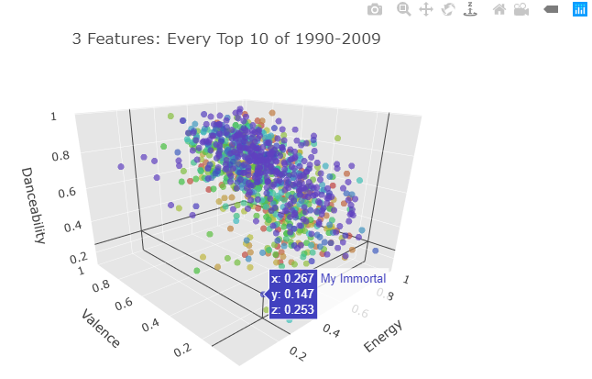
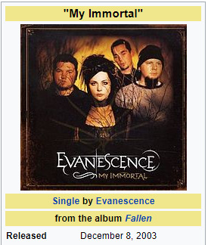
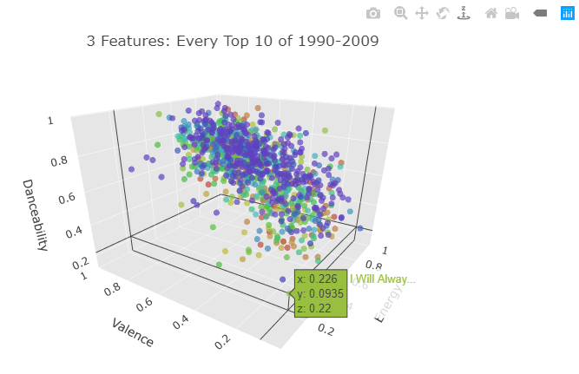
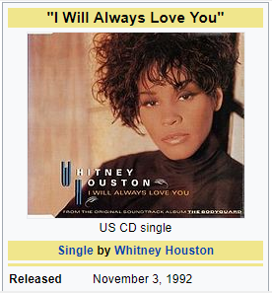
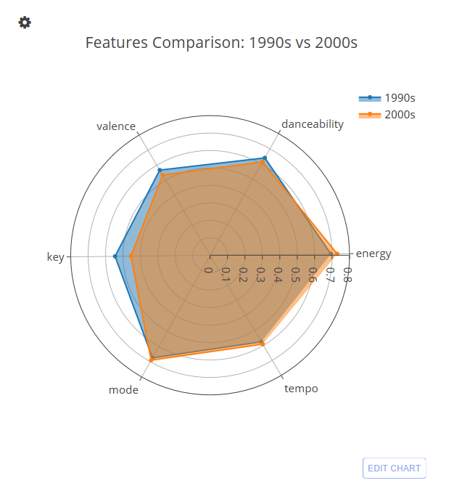

Slide 9
